Slide 1
Getting Started
with AWS
Table of Contents
▶
▶
▶
▶
▶
Introduction to AWS
What does AWS oﬀer?
AWS Infrastructure
AWS Free Tier
Creating an AWS Account
2

Slide 2

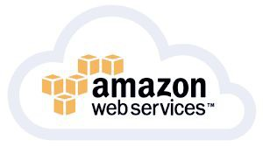
Introduction to
1
AWS
Introduction to AWS
What
is AWS?
• AWS stands for Amazon Web Services.
• Amazon Web Services (AWS) is the world’s most comprehensive and broadly adopted Cloud Platform.
4

Slide 3


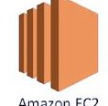



Introduction to AWS
What is AWS?
IAM
S3
EC2
Cloudformation
Elastic
Beanstalk
5
•
AWS offers over 200 fully featured services
•
Millions of customers are using AWS
more agile, and innovate faster.
to
lower
costs,
become
5
Introduction to AWS
AWS launched its first service in 2004. Over
the years, many new services were put into
service. But in this diagram, the real breaking
point started in 2006, when AWS allowed
developer begin to access to Amazon's own
back-end technology and own infrastructure.
History of AWS
2000
came into picture
2004 The first Service SQS was launched.
2006 AWS Launches S3, and EC2-Access allow
2007 Simple DB
2008
Elastic IPs, EBS, Cloud Front,
2009 VPC, RDS, Route 53
Cloud Formation 2010
Dynamo
DB, Glacier, Redshift 2012
CloudTrail, Kinesis, Lambda 2013
Aurora 2014
EC2 Container Service 2016
Elastic Kubernetes Service 2018
6

Slide 4
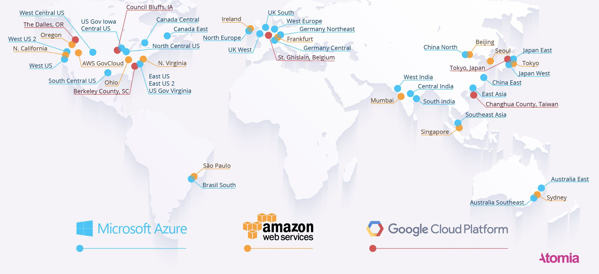
Introduction to AWS
AWS
Features
Scalable
Easy to
Use
Flexible
Secure
Cost- Effective
7
Introduction to AWS
AWS
Market
Share
AWS 32.4%
Azure 17.6%, Google Cloud 6%, Alibaba Cloud 5.4% Others 38.5%.
8

Slide 5
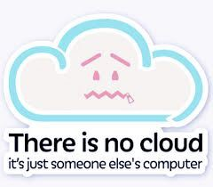
Introduction to AWS
AWS
Pros
• AWS offers more than 5 times the computation capacity in use compared to the aggregate of the other 14 leading market providers.
• With hundreds of thousands of customers operating every possible use case on AWS in over 190 countries.
• Thousands of independent software vendors such as SAP, Oracle, Adobe, Microsoft, etc.
•Amazon Web Services currently supports over 2,000 government agencies and 5000 educational institutions.
9
Introduction to AWS
AWS
Cons
● Sometimes a difficult
learning curve for large
companies
● Billing can be confusing
● Amazon’s EC2 Limits
● Common Cloud Computing problems
10

Slide 6
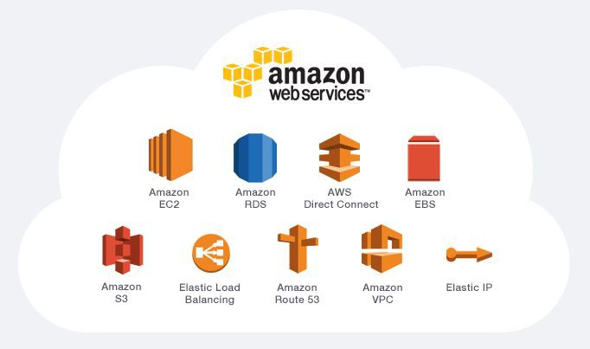
What does AWS oﬀer?
2
What does AWS oﬀer?
AWS
Services
12
12

Slide 7








What does AWS oﬀer?
13
www.e-commerce...
13
What does AWS oﬀer?
www.e-commerce..
S3
Publishing the website
EC2

Slide 8





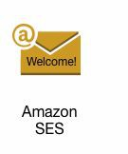
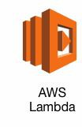


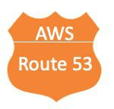








www.e-commerce.
trigger
..
S3
Personel
customer
Sign Up
CloudFront
VPC
- Web Server work in EC2 machine
(nginx-apache httpd)
- Auto Scaling
- Load Balancing
^{- Register domain name} ₋
^{of the website} _{- Inv}
-Publishing on Internet
-Routing –region-language
-Data Log
-Customer
-System
entory List etc.
record
info
Backups
Best seller images,
EC2
S3
RDS
Problem,bug vs..
Developer
- Inventory changed
- Price Changed
- Sale
- Discount, etc.
Change the code
Versioning CSS, HTML
Publish in Public
Hook
function
Internet
EC2
Build& Deploy Pipeline
Send-EC2 server
Git Commit

Slide 9






AWS Well-Architected
Framework
6
Pillars
Operational Excellence Pillar
Security Pillar
Reliability Pillar
Performance Eﬃciency Pillar
Cost Optimization Pillar
Sustainability Pillar
AWS
3
Infrastructure

Slide 10

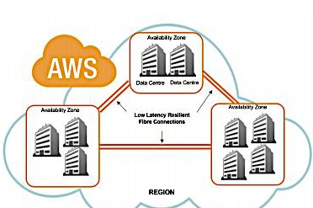
AWS Infrastructure
Introduction
Region
31
Availability
Zones
9
19
9
Data Centers
19
AWS Infrastructure
Introduction
20
• AWS Regions and Availability Zones
• Multiple Availability Zones in AWS Region*
• Availability Zones consist of one or more discrete Data Centers
* Asia Pacific(Osaka) Local Region have only one Availability Zone.
20

Slide 11
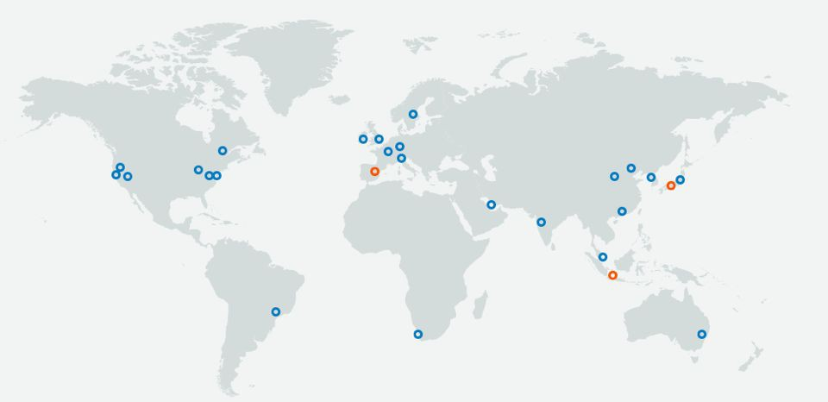
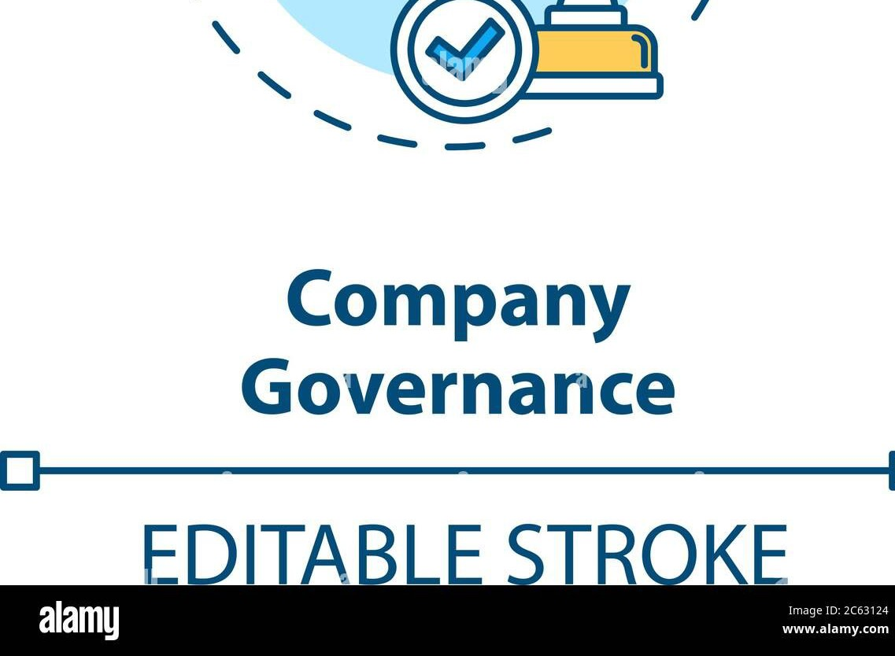
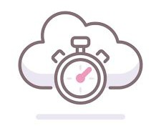



AWS Infrastructure
_{AWS Regions}
31 Geographic
Regions
Current Regions
N. Virginia, Ireland and
Singapore are the
regions with the most
service-support in their
continents. In the other
regions, not all services
of AWS are in progress
Ireland
N.Virginia
21
Singapore
New Regions coming soon (Canada, Israel, Malaysia, New Zealand, and Thailand. )
21
AWS Infrastructure
Factors
Impacting
Region
Selection
22
Governance and
Legal Requirements
Latency
Cost
Service availability
22

Slide 12
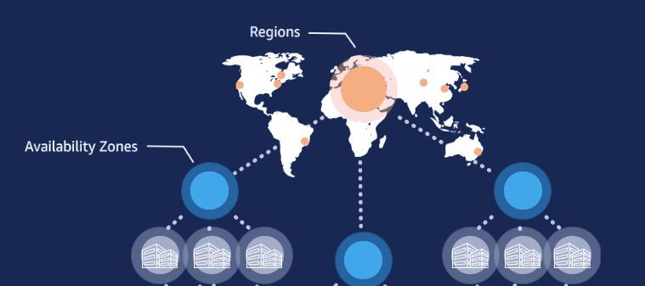

AWS Infrastructure
76 Availability
Zones
AWS Availability
Zones
23
60 miles
60 miles
60 miles
23
AWS Infrastructure
76 Availability
Zones
AWS Availability
Zones
60 miles
● An Availability Zone is a facility where the data centers are located.
● There are currently 99 Availability Zones
● All AZ’s in an AWS region are interconnected with metro fiber.
● All traffic between AZ’s is encrypted.
AZ’s are physically separated by a meaningful distance, many kilometers, from any
other az, although all are within 100 km (60 miles of each other).
24
24

Slide 13
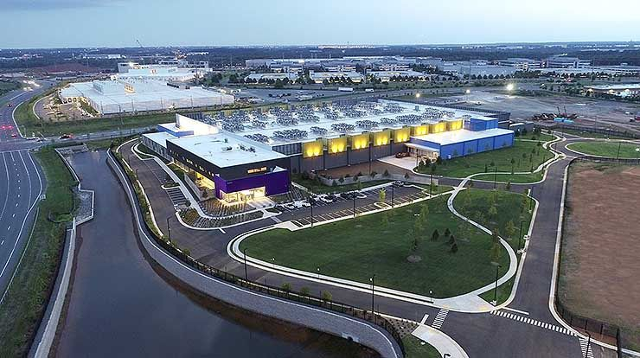



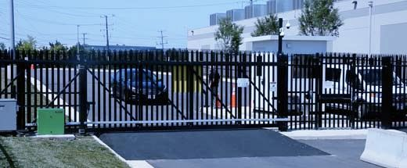

AWS Infrastructure
AWS Data Centers
•
The data center infrastructur
25
e consists
of
physical or
hardware-based tools and
components.
•
Data centers are where
information is stored.
our
•
AWS
data
centers
are
secure by design.
Northern Virginia Data Center
25
AWS Infrastructure
AWS
Data
Centers
Layers
26
Infrastructure Layer
Data Layer
Perimeter Layer
Environmental Layer
26

Slide 14
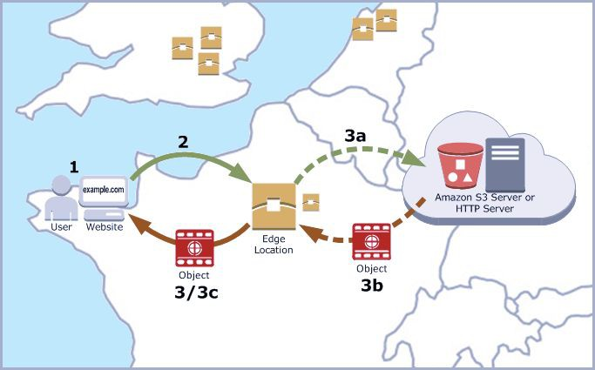
AWS Infrastructure
Edge Locations
27
• An edge location is where end-users access services located at AWS and used for caching content.
• 400 + Edge Locations
First Query
: 1-2-3a-3b-3c-1
Second Query : 1-2-3-1
27
AWS Infrastructure
AWS
Local
Zones
28
AWS Local Zones are a new type of AWS infrastructure deployment that places AWS compute, storage, database, and other select services closer to large population, industry, and IT centers where no AWS Region exists today.
• Each AWS Local Zone location is an extension of an AWS Region
• There are 32 Local Zones currently
28

Slide 15
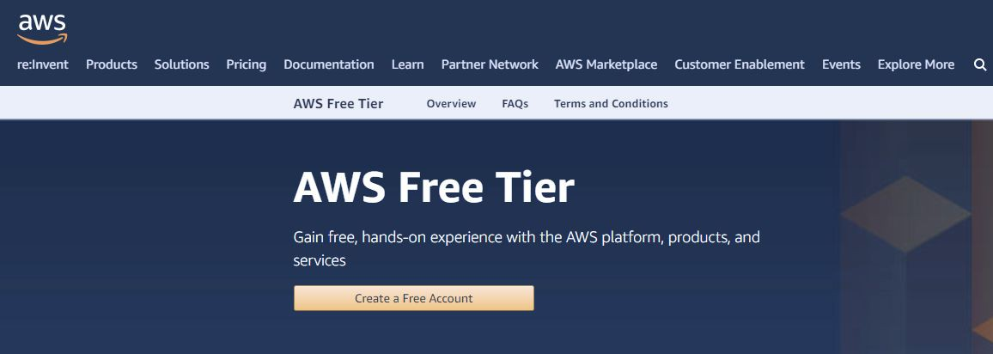
AWS Free Tier
4
AWS Free Tier
What is AWS Free Tier?
30
30
●
The AWS free tier is a account type that lets you gain free, hands-on
experience with AWS products and services.
●
The AWS free tier provides customers the ability to explore and try out aws
services free of charge up to specified limits for each service.

Slide 16

AWS Free Tier
Free Tier Offer Types
31
The Free Tier is comprised of three different types of offerings;
●
Services with a 12-month free tier allow customers to use the product
for free up to specified limits for one year from the date the account
was created.
●
Services with an always free offer allow customers to use the product
for free up to specified limits as long as they are an aws customer.
●
Services with a short term trial are free to use for a specified period of
time or up to a one-time limit depending on the service selected.
31
AWS Free Tier
Billing
Policy
• You are recommended to set a billing alarm to stay within the limits.
• If your application use exceeds the free tier limits, you simply pay standard, pay-as-you-go service rates.
• AWS Free Tier is applied to your monthly usage. It will expire on the 1st day of each month and does not accumulate.
32

Slide 17
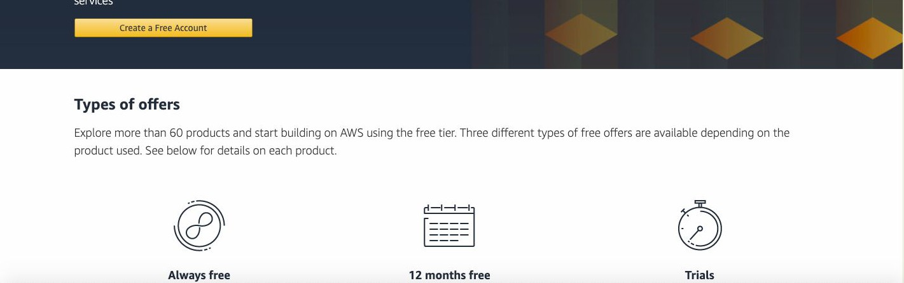
Creating AWS Free Tier
4
Creating AWS Free Tier
https://aws.amazon.com/free
• First, Enter the browser:
• Then click, "Create Free Account"
34
34

Slide 18
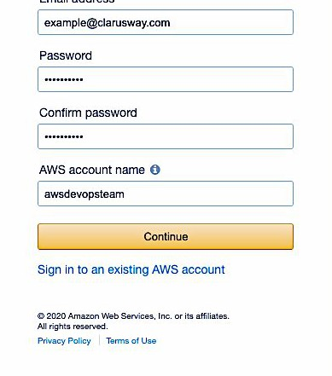

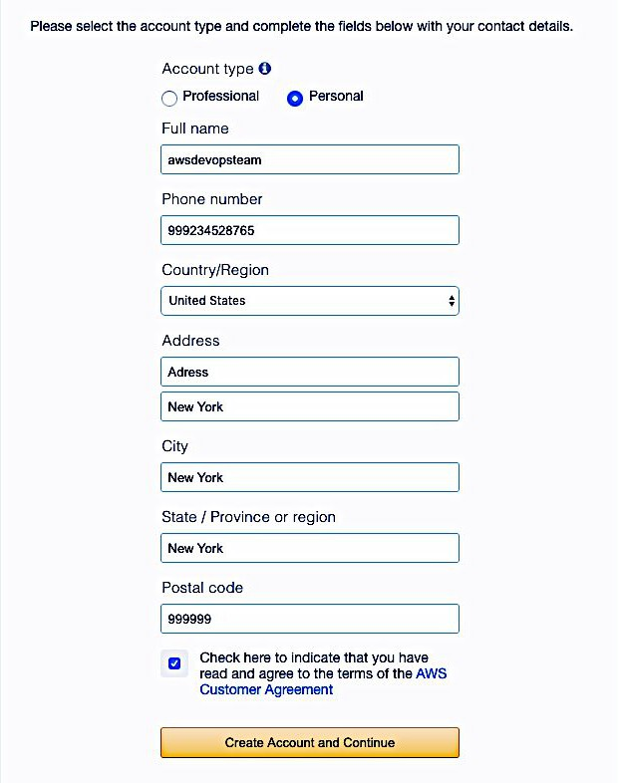
Creating AWS Free Tier
• On clicking on the "Create Free Account" button, the following screen appears that requires some fields to be filled by the user including email address, password and account name.
35
35
Creating AWS Free Tier
•
Select "Personal" as an account
Type
and
then
fill
your
contact
1234567889
information.
xxxxxxxxxxx
36
xxxxxxxxxxx
xxxxxxxxxxx
xxxxxxxxxxx
xxxxxxxxxxx
36

Slide 19
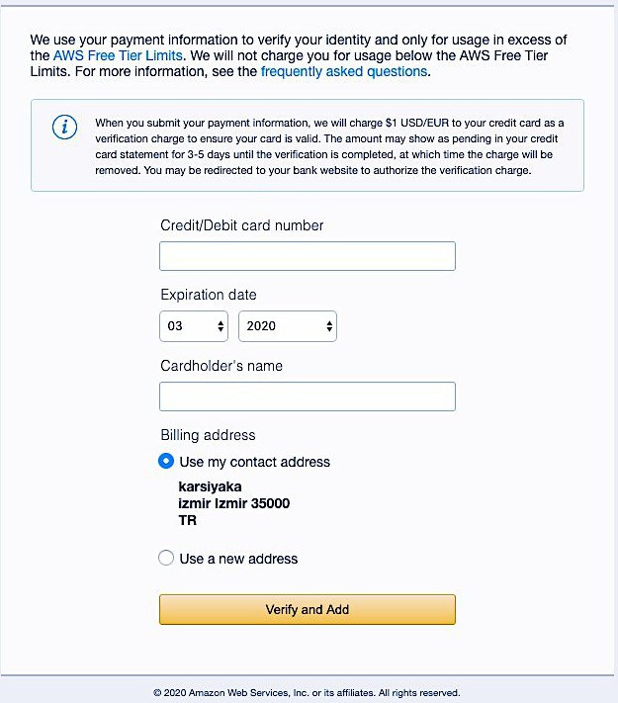

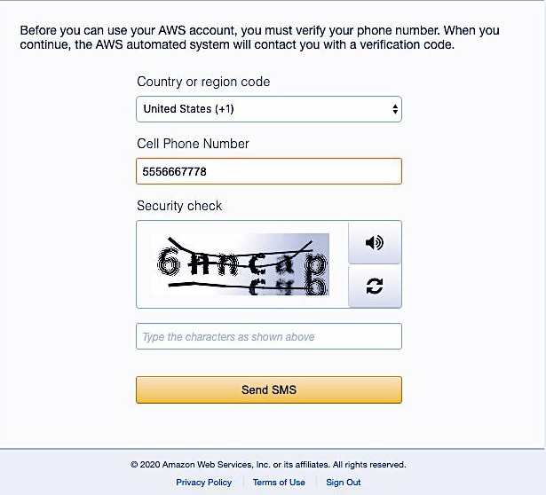
Creating AWS Free Tier
• Fill your payment information.
37
xxxxxxxxxxx
xx
xxxx
Xxxxxx. XXXXX
37
Creating AWS Free Tier
•
Confirm your identity by entering
your phone number and
code displayed in the
captcha.
38
•
Choose "Contact me ".
•
If you chose to verify your account by
SMS, choose "Send SMS"
instead, like in the picture.
(123) 4567899
•
Then enter the PIN you receive by
text message or voice call, and
then choose "Continue".
6nncap
38

Slide 20
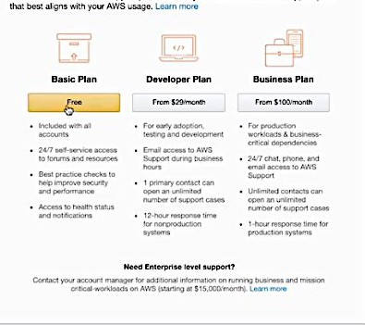
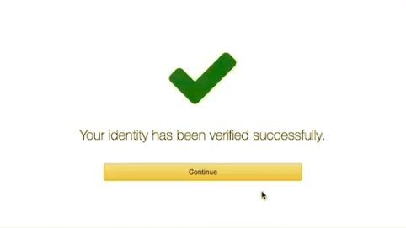

Creating AWS Free Tier
•
After verification, select the
support Plan. Choose the
"Basic Plan " which is free.
39
39
THANKS!
Any questions?
You can ﬁnd me at:
emre.yalcin-ext@bshg.com
40

